Slide 1
Slide Title for Accessibility 01
Workshop on Digital Twins for Dependability, Resilience and Security (DT4DRS) at DSN 2025
Using Digital Twins as an Upgrade Path for Critical Infrastructure Control Systems
Huzaifah Nadeem and Dr. Amy Babay
June 23, 2025

Slide 2






Slide Title for Accessibility 09
Supervisory Control and Data Acquisition (SCADA) systems
Control Center
SCADA systems control and operate power grid infrastructure
Critical to other systems
Servers, known as SCADA Masters (SMs), process clients’ updates and commands
Clients
Human Machine Interfaces (HMI)
Remote Terminal Units (RTU)
Programmable Logic Controllers (PLC)
HMIs
SMs
SCADA
Network
PLCs/RTUs
Remote Physical Equipment (Substation)

Slide 3

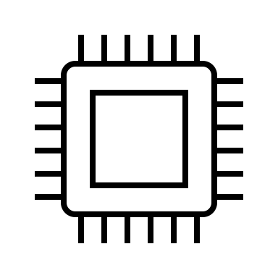







Slide Title for Accessibility 09
Resilience in SCADA systems
Today’s systems are vulnerable to cyberattacks
Intrusion-Tolerant Digital Twins offer a path to transition
We know how to build more resilient systems
HMI
PLCs, other devices
HMI
PLCs, other devices
HMI
PLCs, other devices
…
…
…
Intrusion-Tolerant Digital Twins will enable us to transition today’s vulnerable SCADA systems to intrusion tolerant architectures
Primary SCADA Server
Backup SCADA Server
Primary + Backup SCADA Servers
Replicated, Diverse SCADA Servers
SCADA IT DT
Modern Industrial SCADA
Out-of-band output comparison
Intrusion-Tolerant SCADA
“Network-Attack-Resilient Intrusion-Tolerant SCADA for the Power Grid”
A. Babay, T. Tantillo, T. Aron, M. Platania, and Y. Amir, IEEE DSN, 2018
Out-of-band output comparison supports intrusion detection in the near term
“On the Challenges of Building a BFT SCADA”
A. Nogueira, M. Garcia, A. Bessani, and N. Neves, IEEE DSN, 2018
Notes:
mention Byzantine Fault Tolerance and consensus

Slide 4








Slide Title for Accessibility 09
Upgrades for Emerging Threats
HMI
PLCs, other devices
HMI
PLCs, other devices
HMI
PLCs, other devices
…
…
…
?
Intrusion-Tolerant Digital Twins will enable easily upgrading architectures to address new threats
Primary SCADA Server
Backup SCADA Server
Replicated, Diverse SCADA Servers
Upgraded Intrusion-Tolerant SCADA
Modern Industrial SCADA
Intrusion-Tolerant SCADA
Intrusion-tolerant DT deployment
Upgraded Intrusion-tolerant DT deployment
“Tolerating Compound Threats in Critical Infrastructure Control Systems”
S. Bommareddy, M. Khan, H. Nadeem, B. Gilby, I. Chiu, J. W. van de Lindt, O. Nofal, M. Panteli, L. Wells II, Y. Amir, and A. Babay, SRDS 2024

Slide 5
Slide Title for Accessibility 09
Design Considerations
The system should not have to go offline for each upgrade
Protocol differences should not limit us with component upgrades
We should be able to seamlessly transfer control from one instance to another
Should not require a lot of set up
Trusted administrator
Ability to compare system instances’ logs
To verify that all instances are behaving the same way
Helps build confidence before we actually transfer control to one particular instance
Notes:
- new components can have different protocols and might not work with existing stuff like you dont have to update your HMI etc when you are updating replicas
- being able to seamlessly transfer control. how do you initiate a control transfer? you need a trusted administrator. easily initiate this without a lot of set up
- being able to compare system logs and tell if they are doing the same thing before we actually commit to using one particular system instance

Slide 6
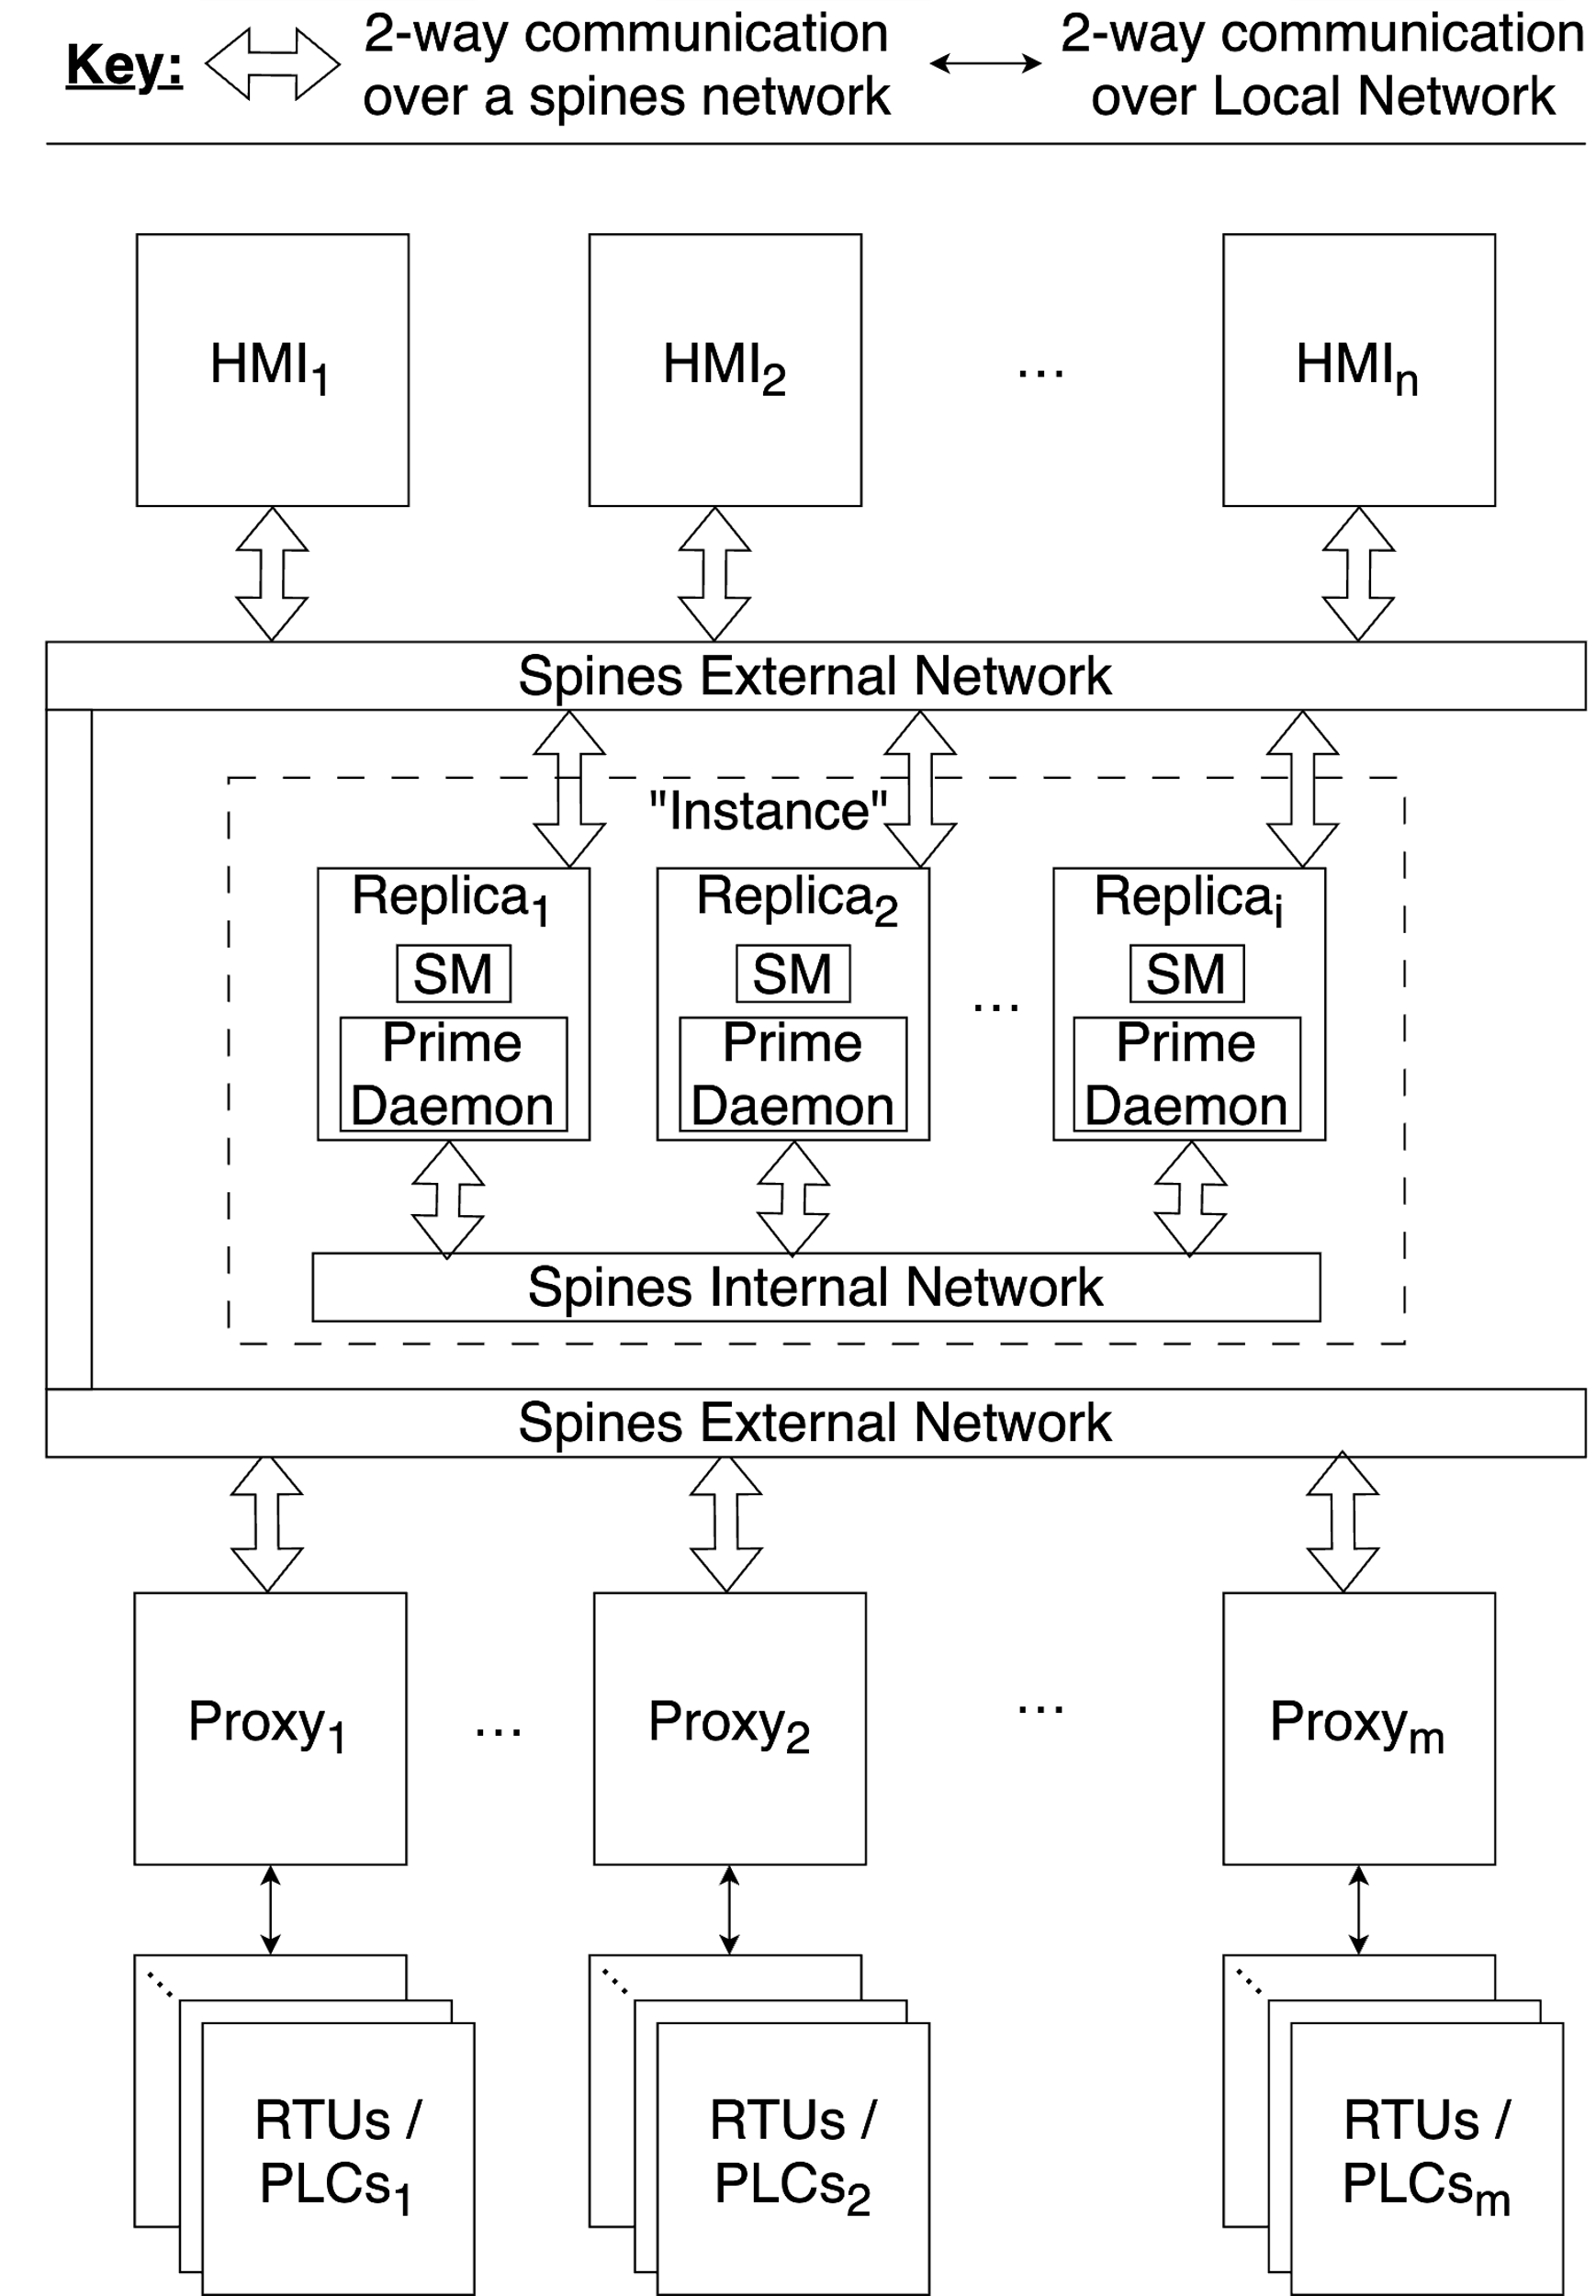
Slide Title for Accessibility 09
Spire – an Intrusion-Tolerant SCADA system
Clients: HMI, RTUs, and PLCs
Proxies:
Translate DNP3 and Modbus protocols used by RTUs and PLCs for the rest of the system
Verifies signatures of the messages going to its clients and sign messages going out to the SMs.
Replicas:
SM for application logic
Prime Daemons for consensus protocol logic
Overlay networks using Spines
“Prime: Byzantine Replication Under Attack”
Y. Amir, B. Coan, J. Kirsch, J. Lane
IEEE Transactions on Dependable and Secure Computing 2011
“Practical Intrusion-Tolerant Networks”
D. Obenshain, T. Tantillo, A. Babay, J. Schultz, A. Newell, M. Hoque, Y. Amir, and C. Nita-Rotaru
ICDCS 2016

Slide 7
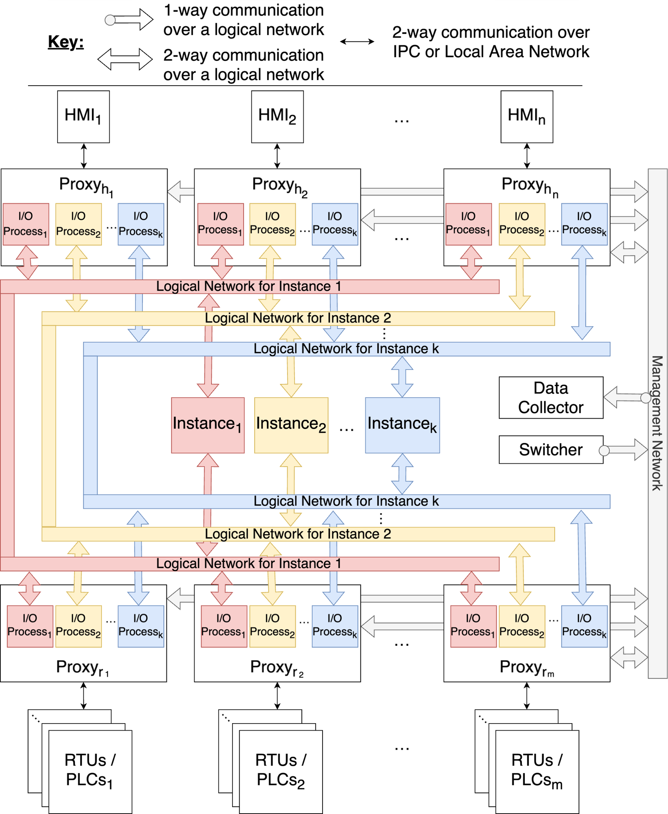
Slide Title for Accessibility 09
Design and Technique Overview
Main idea: have parallel live-running digital twin instance of our system
One active instance with a number of twin instances
The instances can differ in terms of the configurations they use, code-level diversity, and even the communication protocols they use.
We used Spire as our base
Modifications and additions to Spire
Proxies
Data Collector
Switcher
Management Network for communication between these new components
modified
new

Slide 8
Slide Title for Accessibility 09
Proxies
Clients
Proxies mirror messages between the clients and the system instances
Internally, each instance has a corresponding process for communication (I/O Process)
I/O processes also allow us to easily add and remove instances from the system by forking new processes or killing existing processes without the proxy needing to go offline
These processes can manage any necessary translation that may be required for communication with an instance
Proxy
I/O Process 1
I/O Process 2
I/O Process k
…
Instance 1
Instance 2
…
Instance k
Notes:
emphasize the point about translation

Slide 9
Slide Title for Accessibility 09
Updates and Commands from the instances and clients
Data Collector
Data Collector stores all of the instances’ logs
It receives all the messages that the proxies receive and forward
Here an intrusion detection algorithm can run that compares the different instances logs to detect anomalies
The logs are also useful for the operator to analyze and build confidence on using a particular configuration
Proxy 1
Proxy 2
…
Proxy n
Forwards copies of the messages
Management Network
Data Collector

Slide 10
Slide Title for Accessibility 09
Switcher
Operator enters a command
Switcher
The operator can seamlessly transfer control between the instances by using the Switcher.
After entering the relevant command into the Switcher, it sends a message to the proxies via the management network
The proxies then handle the updates to the data structures to forward messages to the right places and handle addition/removal of the relevant I/O Processes
Switcher only needs to be online when the operator wants to send a message
Data Collector
Multicast
Management Network
Proxy 1
Proxy 2
…
Proxy n
Proxies update the data structures and add/remove I/O Processes as necessary

Slide 11
Slide Title for Accessibility 09
Management Network
Proxy 1
Proxy 2
…
Proxy n
The management network connects these new components
The management network can be a separate physical network, or a logical overlay network on top of the existing physical network
For our prototype, we use Spines to deploy the management network as an overlay
Management Network
Data Collector
Switcher

Slide 12
Slide Title for Accessibility 09
A Challenge: State Divergence Between the Instances
Since the proxies send messages to the system instances over a network, delays and reordering of messages is possible
That can result in application’s state divergence between the instances
The divergence can also be non-benign in nature, such as if an attacker introduces new commands
It is useful to detect that for intrusion detection
Proxy
m₁
m₁
Network can reorder and delay messages
m₂
m₃
m₃
m₄
m₄
m₂
Instance 1
Instance 2
< m₁ ,m₂, m_{3,} m₄>
< m₁ , _, m₃, m_{4,} m₂>

Slide 13
Slide Title for Accessibility 09
A Challenge: State Divergence Between the Instances (cont’d)
We want
to be able to transfer control to a new system instance. For this to work correctly, its state should match that of the previous active instance.
to be able to compare outputs between instances for intrusion detection. However, if outputs can differ for benign reasons, how do we detect problematic/malicious divergence?
For our prototype with Spire, the ground truth is the state at the clients
Therefore, the SMs only update their data structures upon receiving updates from the PLCs/RTUs
This will help us with (1)

Slide 14
Slide Title for Accessibility 09
A Challenge: State Divergence Between the Instances (cont’d)
For (2) i.e., distinguishing between benign and malicious divergence:
If an attacker introduces completely new commands that the other instances’ states do not have, that is detectable by comparing to the other states
However, the attacker can reorder commands
For our specific application, the operator can see the state and if some condition needs to met, that can be verified first before initiating the next command
This is one way of addressing the state divergence issue i.e., have application-specific state divergence solution
However, there may be more general solutions

Slide 15
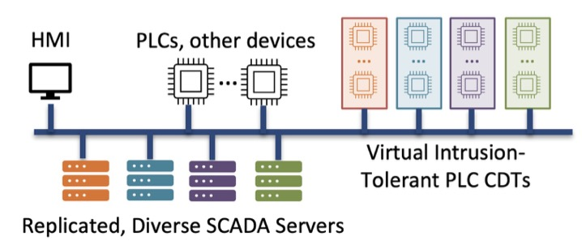
Slide Title for Accessibility 09
Future Directions
Exploration of other solutions regarding our application state divergence
Developing more advanced intrusion detection techniques applied live on the instances’ logs at the data collector
Exploring the possibilities to extend intrusion-tolerant Cyber Digital Twins to the client level (i.e., RTUs, PLCs, HMIs.)
Conducting a real-world case study where we use this technique and approach as an upgrade path for a deployed system
Increasing the scope and the ideas applied to other control systems or Cyber-Physical systems more broadly.
Notes:
We are already working on point 4 about doing it on a real SCADA system. can mention energy innovation center.

Slide 16
Slide Title for Accessibility 09
Conclusion
We developed an approach on using digital twins to make system upgrades easier and more manageable.
This approach will help, now and in the future, with upgrading the systems without making the systems go offline.
Other benefits include intrusion detection by comparing system instances’ logs
For this, we developed a prototype on a real SCADA system Spire
We also described the issues and challenges we encountered and some possible ways to address them.
Notes:
Emphasize point #2

Slide 17
Slide Title for Accessibility 21
Questions?
h.nadeem@pitt.edu

